Slide 1

Supervised Learning: Predicting the Future with Data
Supervised learning is a powerful AI approach. It leverages labeled datasets to predict outcomes. This technology powers innovations in various fields, from self-driving cars to medical diagnosis. The market for supervised learning is projected for significant growth.

Slide 2
What is Supervised Learning?
Learning from Examples
Labeled Data is Key
Generalizing to New Data
This process requires "labeled data": known input-output pairs (X, Y).
It learns a mapping function from input variables (X) to an output variable (Y).
The model learns from examples, then applies that knowledge to unseen data.
This differentiates it from unsupervised learning, which uses unlabeled data.

Slide 3
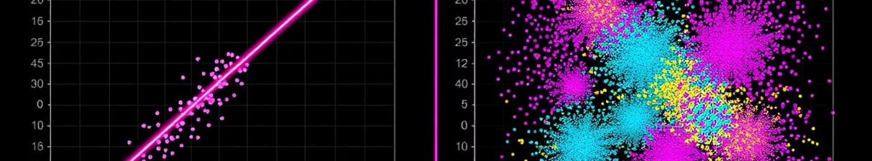
Supervised Learning Categories
Regression
Classification
Common Algorithms
Predicts a continuous numerical output, such as house prices or temperature.
Predicts a discrete categorical output, like spam/not spam or disease/no disease.
Includes Linear Regression, Logistic Regression, Support Vector Machines, and Decision Trees.

Slide 4
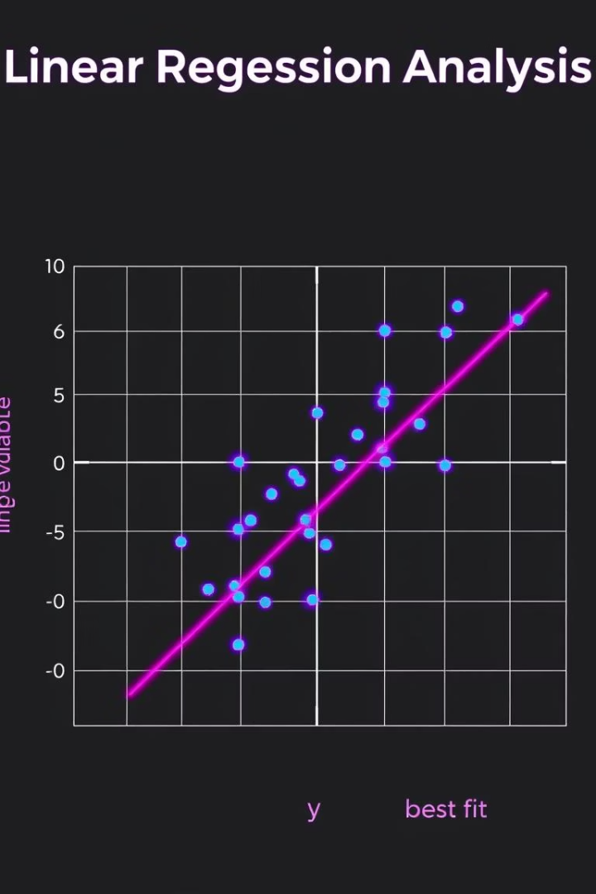

Regression: Predicting Continuous Values
Objective
Linear Regression
Models the relationship between inputs and a continuous numerical output.
A common algorithm for continuous prediction.
The Equation
Where y is the prediction, xᵢ are features, βᵢ are learned weights, and ε is the error.
The model minimizes the sum of squared differences between predicted and actual values.

Slide 5





Regression Applications
Real Estate
Sales Forecasting
Climate Prediction
Financial Services
Zillow's "Zestimate" predicts home values with high accuracy for on-market homes.
Retailers use models to predict demand, reducing stockouts significantly.
NOAA forecasts global temperatures with high precision in short-term models.
Predicting stock prices and bond yields for quantitative trading firms.

Slide 6






Classification: Categorizing Data Points
Goal
Assign data points to predefined categories or classes.
Logistic Regression
A common algorithm for binary classification.
The Equation
This maps the output to a probability between 0 and 1.
Decision Point
A threshold converts the probability into a class label.

Slide 7

Classification Applications
100M
90%
$B
Spam Emails
Medical Accuracy
Fraud Savings
Gmail filters daily using classification models.
Banks detect most credit card fraud attempts.
AI models detect early-stage diseases.
95%
Image Accuracy
Google Photos identifies objects and faces.

Slide 8







Conclusion: The Power of Labeled Data
AI Foundation
Actionable Insights
Supervised learning is fundamental to modern AI systems.
It transforms raw data into valuable predictions.
2
Future Expansion
Continuous Innovation
Future capabilities will extend into new domains.
Ongoing advancements drive more impactful applications.

